Slide 1
EPG Incorporated
Financial Managers Society
Implications of Rising Rates on Balance Sheet Management in 2015
February 24, 2015
Jonathan Rankin, Senior Vice President

Slide 2
Agenda
Interest Rates and the Fed
Implications for 2015
Enhancing your Modeling Precision

Slide 3
Interest Rates and the Fed

Slide 4
(Quick) Economic Update
Solid, yet not sensational growth in 2014
Steady payroll growth, improving lately, however, job quality still suspect: ‘Headline’ vs. real unemployment
Income growth picking up, but little consumer spending growth so far: Impact of the Walmart announcement?
Gov’t spending remains constrained by move toward fiscal conservatism: House/Senate leadership vs. the President

Slide 5
U.S. the Bright Spot in the World?
Although 2.5% GDP growth may not sound fantastic, consider the alternatives:
Europe: days of high-growth gone forever?
Japan: emerging from recession
Russia/Iran/Venezuela: impact of oil price decline
Greece: essentially in a battle with Germany
China: ????
➔ Will the rest of the world drag down the U.S. economy?

Slide 6
Foreign bond markets make US debt attractive by comparison
Foreign demand for US government debt supporting the bond market- compare yields in Japan and Germany
Consider the 10-year JGB at 0.37%: a pick-up in yield of 172bp is very meaningful in a low growth/low inflation world. Peripheral bond markets such as Italy and Spain have yields below the US. French and German bond yields have fallen below 0.75%.
Compare the liquidity and strength of the US bond market (as well as the history of the Fed) to global alternatives- US yields look extremely attractive

Slide 7
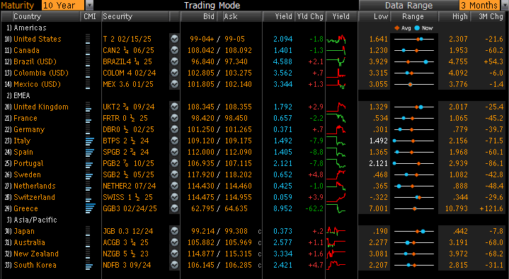
Global Rate Comparisons Favor US Debt
10 YR debt comparison:
Spain @ 1.40% vs. U.S. Treasury @ 2.09%
Which would you buy?
Source Bloomberg

Slide 8
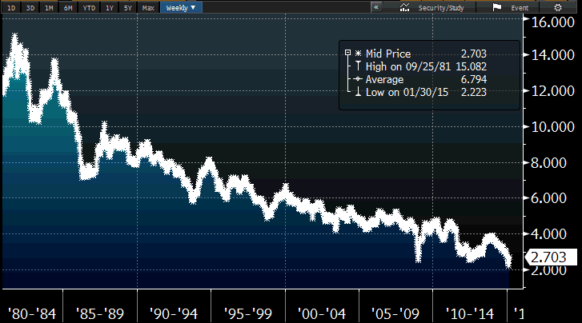
Thirty-year treasury yields
➔ Is this a bubble of historic proportions?
Source Bloomberg

Slide 9
The Fed Now Has Three Mandates
• Inflation
• Full Employment
• Financial Stability (as a result of Dodd Frank)
Fed funds are likely to be raised as a result of the third mandate, not either of the first two.
➔ What are the implications?

Slide 10
The Fed’s Challenging Agenda
We believe the Fed thinks that in order to retain relevance as well as avoid “moral hazard” they need to raise rates “sooner rather than later”.
They may believe the longer they wait, the greater the risk that either the economy turns lower and they are unable to act (by cutting rates since rates are still at zero) or the economy reaches escape velocity and the market believes they are “behind the curve”.

Slide 11
Terminal Rate for Fed Funds to Remain Low
The Fed Funds rate may remain historically low once the tightening cycle begins- the “terminal” rate, the peak in the funds rate for this tightening cycle, could be 3% or lower.
Market expectations for a lower terminal rate have appeared recently, declining from 4% to 3.75%, and we believe they have further to fall.
A 2% funds rate remains a distinct possibility if growth is unable to accelerate beyond the 5 year average of 2.3%

Slide 12
Current EPG Rate Forecast

Slide 13
Implications for 2015

Slide 14
How May Rates Impact Pricing Decisions?
The Loan Portfolio
Fixed rate mortgages
Can you afford to sell all your new 30-year production?
If no, how much are you comfortable holding? How does a lower Fed terminal rate impact your decision?
Have you seen a pick-up in refi activity?
Commercial Real Estate
Very optimistic growth expectations for 2015
Competition will keep rates low, impacting margins
Purchased Loans

Slide 15
How May Rates Impact Balance Sheet Mgt?
Investment Portfolio
Impact of flatter yield curve on investment portfolio management
Slope of the curve, Feb 2014: 243 basis points
Slope of the curve, Feb 2015: 138 basis points
Significantly less benefit to extending out on the curve
Lower nominal rates: smaller ‘penalty’ for holding extra liquidity
Keep powder dry for future opportunities?

Slide 16
How May Rates Impact Pricing Decisions?
Deposits
Non-Maturity Deposits
Slowly rising rates may allow for more lag
Reward depositors that are willing to take action through new higher rate accounts- may not be necessary to pay-up across the board
Certificates
Consider the Fed Funds terminal rate when pricing longer term funding
Be aware of how much upside rate protection you need

Slide 17
How May Rates Impact Pricing Decisions?
External Funding
FHLB Advances
Take advantage of current ultra-low short term rates to boost earnings- provides flexibility and can be extended on short notice
Recent drop in rates allows us another opportunity (maybe the final one) to extend before rates move- but avoid over-hedging
Listing Services
Patience pays-off
➔ Anticipated slow move in rates should allow for higher short-term balances, but be prepared to act!

Slide 18
➔ Identify and utilize excess risk capacity
Projected Earnings / IRR Profile
 | IRR Profile
Projected Earnings | Low / Low | Low / High
 | High / Low | High / High

Slide 19
Enhancing Your
Modeling Precision

Slide 20
Modeling Data
‘Hard’ data: contractual terms of loans and deposits- maturity dates, rates, balances, spreads, caps, floors
Objective: Definite ‘right or wrong’
Incomplete data can lead to incorrect modeling results
‘Soft’ data: key modeling assumptions such as repricing assumptions, discount rates, prepay speeds and NMD
Subjective: No definitive ‘right or wrong’
Weak data can lead to unreliable modeling results
The more accurate the results, the more useful they will be for balance sheet management purposes

Slide 21
Key Modeling Assumptions
Repricing assumptions (called ‘betas’ or rate sensitivity factors): Attempt to match future management pricing decisions
Discount rates: Drive EVE/NEV results
Prepayment speeds: Impact the cashflow projections
Non-maturity deposits: Biggest driver of modeled results
All should vary with changing rate environments
➔ Assumptions are the key to reliable modeling!

Slide 22
Modeling Parameters
Static vs. Dynamic modeling: IRR Advisory, Jan 2010
NII, EVE/NEV, or both?
Data disaggregation: Whose CRE portfolio is all one rate? Also vital for helocs with varying floors/spreads
Balance sheet management tool

Slide 23
Sensitivity Testing
Tests the impact of the assumptions on the modeled results- what if our assumptions are unreliable?
Examples include:
Higher non-maturity deposit costs
More dramatic shift in the deposit mix
Faster/slower prepay speeds
Shorter NMD lives
Early withdrawal of CD funding

Slide 24
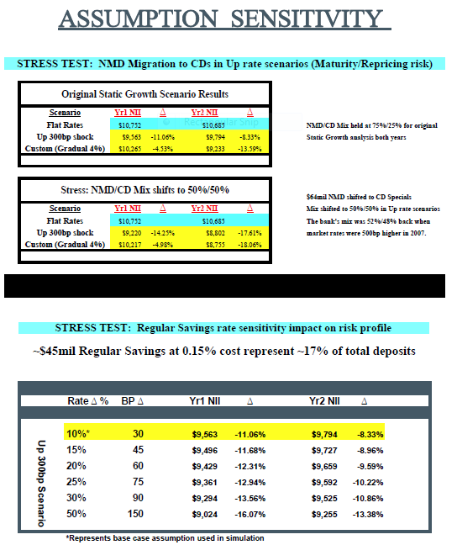
Sensitivity Testing

Slide 25
Evaluating The Results
Points to Consider:
Earnings pressure (could be business plan or regulatory driven): don’t over-hedge…
Proximity to policy guidelines
Tolerance for external funding (objective as well as subjective)
Board governance: Oversight of the process/ownership of the assumptions
Capital
New loan growth not necessary to adjust funding mix

Slide 26
EPG Incorporated
Questions?
Please contact Jon Rankin at jrankin@epgadv.com
60 William St., Suite 240 | Wellesley, MA 02481
(800) 535-4544
www.epgadv.com
“The information provided in this report is based on data received by a variety of sources we believe are reliable but cannot be guaranteed. Such sources as brokerage confirmations, client communications, and various pricing services are utilized. Every effort to ensure accuracy within these limitations is taken. However, due to the nature of the data sources, certain limitations exist. EPG’s client base consists of institutional and individual clients. EPG Incorporated manages Discretionary, Non-Discretionary and Limited Discretion accounts. For Bank clients who choose to impair stock, EPG accounts for the stock as if it were sold, and repurchased at the current market value. This allows EPG to “capture” the change in value due to the write-down of the book value which “impairment” creates.”
The preceding contents prepared by EPG are for general information only and do not constitute investment advice, nor convey any performance claim.

