Slide 1
MAR update Boston Chapter of Financial Managers Society Tuesday, April 28, 2015
Corinne Fitzgerald
2015 President
Massachusetts Association of REALTORS®

Slide 2
How we tell the FUTURE of the Real Estate Market?

Slide 3
Pending Home Sales
REALTOR® Confidence Indexes
Buyers and Sellers Profiles
Notes:
Pending home sales – we are the only group that can report on this
Realtor confidence index – pole members monthly Price & Market
Home buyers and sellers profiles – gather data specific to our area.

Slide 4
March Pending Home Sales
(https://www.flickr.com/photos/horiavarlan/)
Notes:
March buyers couldn’t wait to get out an make offers after a February of snow.
Pending sales of single-family homes and condos both up in March
Single family pending sales have been up 24 of the last 25 months

Slide 5
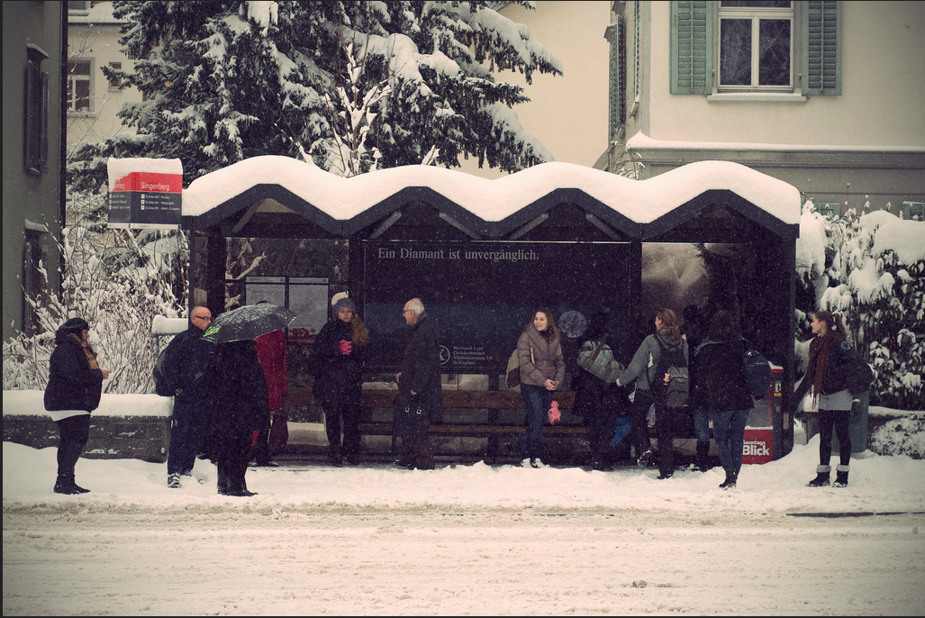
INVENTORY
(https://www.flickr.com/photos/mpsfender182/)
Notes:
Inventory continues to go down
38th straight month of year-over-year inventory decreases - single family
53rd straight month of year-over-year inventory decreases condo’s
Inventory is STILL LOW. Coming on slow.
Sellers were waiting in both February and March for the snow to go before putting their homes on the market

Slide 6
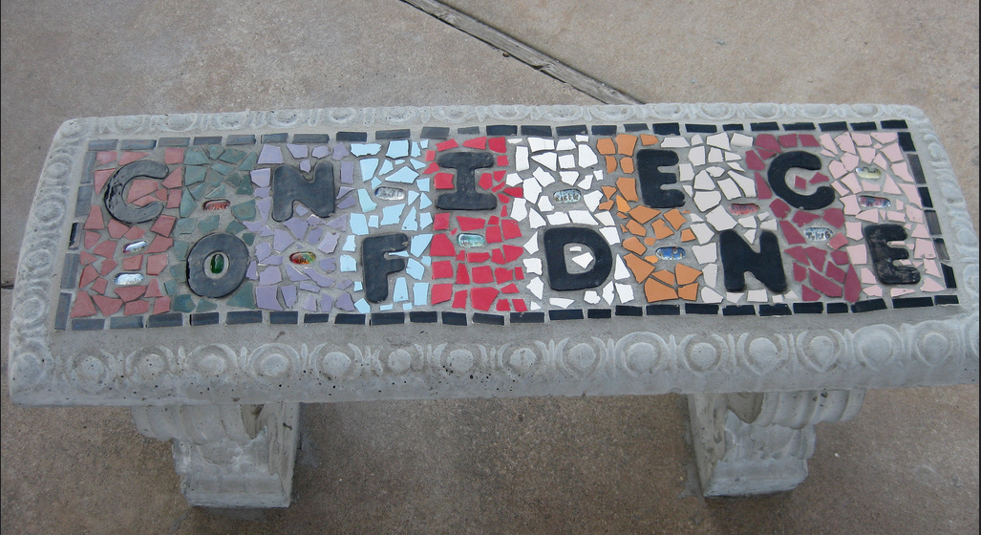
(https://www.flickr.com/photos/glsims99/)
Notes:
WE HAVE Over 7 years of data collected
Realtor rate the Market in general and the price… are you seeing it going up, down or flat.
That creates the REALTOR CONFIDENCE INDEX
Monthly Survey to REALTORS®
(self-selected group)
Survey answers two questions
Additional “Hot Topic” question

Slide 7
Market Confidence Index
Notes:
A score of 50 is the threshold between a “strong” and a “weak” condition

Slide 8
Market Index
Notes:
8 YEAR COMPARISON
All-time high: 83.8 – May, 2013
All-time low: 13.42 – Dec. 2008
Most Recent (March 2015): 69.18 Down less than one half percent

Slide 9
Price Confidence Index
Notes:
WE CALULATE THE PRICE SIMILARLY BY ASKING
“What are THEIR expectations of home prices over the next year?”
Answer Choices:
“Rise 5%+” (100 pts)
“Rise 0-5%” (75 pts)
“Level” (50 pts)
“Fall 0-5%” (25 pts)
“Fall >5%” (0 pts)
A score of 50 is the threshold between a “strong” and a “weak” condition
All-time high: 81.95 – May, 2013
All-time low: 28.22 – Nov. 2008
Most Recent (March 2015): 78.88 (-1%)

Slide 10
Who are the Buyers in this Market?
Photo Courtesy of Colin Kinner - Flikr
Notes:
BUYERS:
39% first-time buyers (lowest level last 12 yrs)
Typical age – first-time 31/repeat 49
65% of recent buyers were married couples
11% bought a MULTI GENERALTIONAL HOME (children moving back in OR AGING PARENTS
Median income (2013) $100,400 First-time $107,400 Repeat

Slide 11
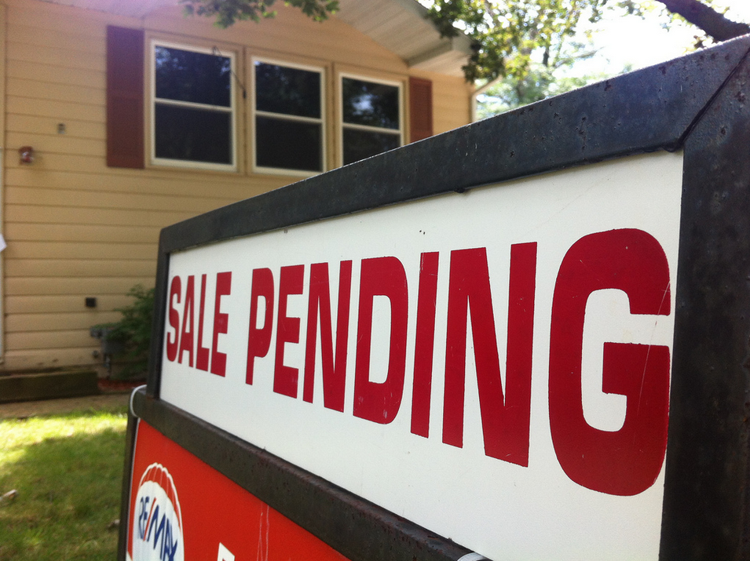
What they bought
(https://www.flickr.com/photos/danmoyle/)
Notes:
What they bought:
Not “new” homes – only 8 percent were new construction
Typical home 1,700 sq ft. and built in 1963 (Nat’l 1,870 sq ft and built in 1993)
The average home search took 16 weeks with 10 homes seen.

Slide 12
Sellers
(https://www.flickr.com/photos/trishhamme/)
Notes:
Sellers:
Lived in their home on average 10 years
88% USED A REAL ESTATE PROFESSIONAL
Home SOLD typically for 98% of the listing price
13% of recent SELLERS DELAYED SELLING their home BECAUSE THEIR VALUE was LESS THEN THEIR MORTGAGE
92% reported their HOME WAS LISTED in the MLS

Slide 13
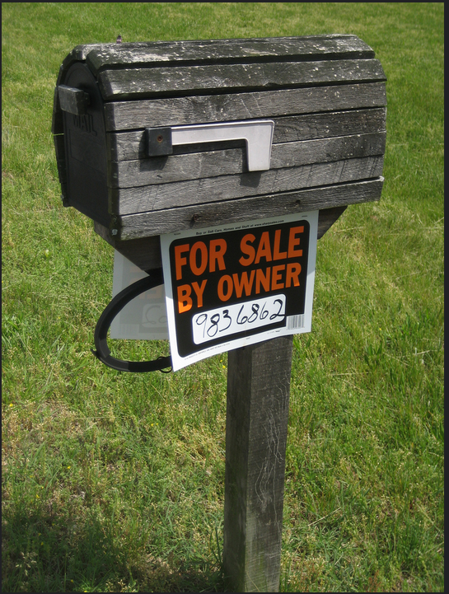
For Sale By Owner (“FSBO”)
Notes:
ONLY 7% of home sellers sold their home w/o a real estate professional
43% of those SELLERS KNEW THE BUYERprior to the home purchase
Why FSBO?
A THIRD--- DID NOT WANT to pay commission
33% sold to a relative, friend, neighbor
33% BUYER contacted SELLER DIRECTLY

Slide 14
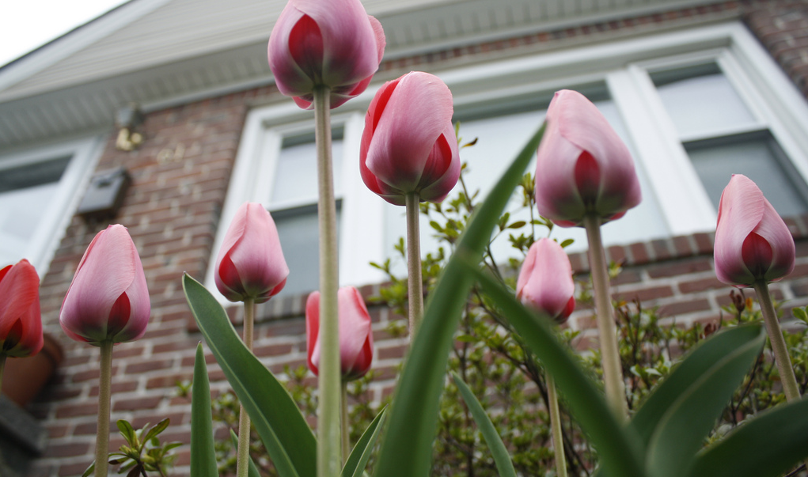
(https://www.flickr.com/photos/goaliej54/)
Notes:
Spring is here!!... And we’re ready!
Prices are up,
Appraisal issues
Active open houses
Pending sales up
So……
If….
Increase Inventory,
interest rates don’t climb too much
and employment stays strong
Crystal ball – active spring.

