Slide 1
Boston Chapter, Financial Managers Society Real Estate Trends And Market Update, 2015
Timothy M. Warren Jr., CEO of The Warren Group
April 28, 2015

Slide 2
Today’s Agenda
Historical Overview of Real Estate Activity In Massachusetts
Sales
Median Prices
Foreclosures
Questions

Slide 3
Sales

Slide 4
Massachusetts Sales Stats # of units sold per year: 1987 – 2014
Copyright © 2015 The Warren Group

Slide 5
Massachusetts Sales Stats Single-Family Homes Sold 1987 – 2014
1999
65,716
2004
64,568
1990
35,819
2014
48,963
2011
39,950
Copyright © 2015 The Warren Group

Slide 6
Massachusetts Sale Stats Single-Family Home Sales % Change By Month
Apr. 2010
46.74%
Nov. 2012
21.39%
Aug. 2011
17.75%
Dec. 2014
9.61%
Jun. 2014
3.69%
Mar. 2015
0.87%
Feb. 2013
-9.30%
Mar. 2014
-7.75%
Nov. 2010
-29.83%
Copyright © 2015 The Warren Group
Notes:
Single-family home sales gained almost 1 percent in March, with 2,778 homes sold compared with 2,754 in March 2014. Home sales in the first quarter were up 1.3 percent to 7,670 from 7,573 in last year’s first quarter.

Slide 7
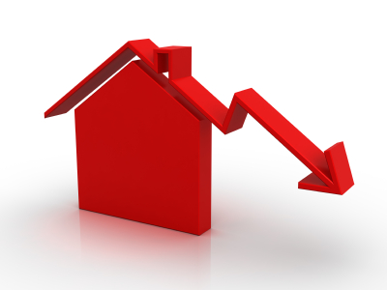
Massachusetts Sales Stats 2011 – YTD Mar. 2015
Single-Family Sales:
2011 2012
39,594 47,401 +19.7%
2012 2013
47,401 49,992 +5.47%
2013 2014
49,992 48,963 -2.04%
YTD Mar. 2014 YTD Mar. 2015
7,573 7,670 + 1.3%
Condo Sales:
2011 2012
15,191 19,037 +25.32%
2012 2013
19,037 20,468 +7.52%
2013 2014
20,468 20,614 +0.71%
YTD Mar. 2014 YTD Mar. 2015
3,420 3,218 - 6.0 %
Copyright © 2015 The Warren Group
Notes:
Single-family home sales gained almost 1 percent in March, with 2,778 homes sold compared with 2,754 in March 2014. Home sales in the first quarter were up 1.3 percent to 7,670 from 7,573 in last year’s first quarter. Condominium sales decreased statewide by 6.0 percent in March 2015 with 1,251 sales down from 1,328 in March of last year. A total of 3,218 condo sales transactions were recorded in the first three months of the year, a 6.0 percent decrease from the 3,420 transactions a year earlier.

Slide 8
Massachusetts Sales Stats Multifamily 2011 – YTD Mar. 2015
2-Family Sales:
2011 2012
4,308 4,792 +11.2%
2012 2013
4,792 4,807 +0.31%
2013 2014
4,807 4,655 -3.16%
YTD Mar. 2014 YTD Mar. 2015
796 786 -1.26%
3-Family Sales:
2011 2012
1,849 1,918 +3.7%
2012 2013
1,918 1,878 -2.1%
2013 2014
1,878 1,889 +0.59%
YTD Mar. 2014 YTD Mar. 2015
358 379 +5.87 %
Copyright © 2015 The Warren Group
Notes:
Row Labels 2014 2015
03
3FA
Sum of NUMSALES 135 132 -2.22%
Sum of YTDNUMSALE 358 379 5.87%
Sum of MEDSALE 287500 314500 9.39%
Sum of YTDMEDSALE 303000 348000 14.85%

Slide 9
Median Prices

Slide 10
Massachusetts Median Price Stats Prices by year: 1987-2014
Copyright © 2015 The Warren Group

Slide 11
Massachusetts Price Stats Single-Family Median Price Trends 1987- 2014
2014
-7% from peak
$330,000
2005:
$355,000
2009 & 11: $285,000
-20% from peak
2000: $215,000
1992, 93: $141,000 -11%
1989:
$157,500
Copyright © 2015 The Warren Group

Slide 12
Massachusetts Price Stats Single-Family Home Prices % Change By Month
April 2013
13.82%
Dec. 2012
12.25%
Sept. 2010
1.05%
Mar. 2015
+ 0.76 %
Sept. 2014
-1.54%
Jan. 2012-3.70%
Jan. 2011
-6.90%
Copyright © 2015 The Warren Group
Notes:
The median price for single-family homes sold in March rose 0.76 percent to $317,400 from $315,000 a year earlier. It was the sixth consecutive month that monthly home prices have increased year-over-year. The first quarter median selling price was $317,500, an almost 4.0 percent increase from $305,000 in the first quarter of 2014.

Slide 13
Massachusetts Median Price Stats 2011 – YTD Mar. 2015
Single-Family Median Price:
2011 2012
$285,000 $290,000 +1.75%
2012 2013
$290,000 $322,000 +11.03%
2013 2014
$322,000 $330,000 +2.48%
YTD Mar. 2014 YTD Mar. 2015
$305,000 $317,500 +4.0%
Condo Median Price:
2011 2012
$270,000 $276,500 +2.41%
2012 2013
$276,500 $298,000 +7.78%
2013 2014
$298,000 $310,000 +4.03%
YTD Mar. 2014 YTD Mar. 2015
$290,000 $297,000 +2.4%
Copyright © 2015 The Warren Group
Notes:
The median price for single-family homes sold in March rose 0.76 percent to $317,400 from $315,000 a year earlier. It was the sixth consecutive month that monthly home prices have increased year-over-year. The first quarter median selling price was $317,500, an almost 4.0 percent increase from $305,000 in the first quarter of 2014.
The median price for condos sold in March was $302,000, up 3.4 percent from $292,190 in March 2014. The first quarter median condo price was also up more than 2.4 percent to $297,000 from $290,000 during the prior year’s first quarter.

Slide 14
Massachusetts Median Price Stats Multifamily 2011 – YTD Mar. 2015
2-Family Median Price:
2011 2012
$230,000 $255,000 +11%
2012 2013
$255,000 $305,000 +18.4%
2013 2014
$305,000 $329,000 +7.7%
YTD Mar. 2014 YTD Mar. 2015
$290,000 $315,000 +8.62%
3-Family Median Price:
2011 2012
$220,000 $252,000 +14.5%
2012 2013
$252,000 $300,662 +19.3%
2013 2014
$300,662 $330,000 +9.8%
YTD Mar. 2014 YTD Mar. 2015
$303,000 $348,000 +14.85%
Copyright © 2015 The Warren Group
Notes:
303000 348000 14.85%

Slide 15
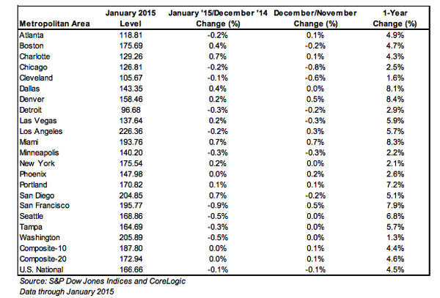
Case Schiller Index

Slide 16
Foreclosure Trends

Slide 17
Mass. Monthly Petitions to Foreclose Jan. 2009- Mar. 2015
Copyright © 2015 The Warren Group
Notes:
Feb. 2015 year-over-year 98 percent increase. 868 foreclosure petitions in February, 2015 compared with 439 a year.
YTD Feb. 2015- petitions rose 85 percent to 1,486 petitions filed compared with 803 during the same time 2014.
July 2009- 2899
Dec. 2100- 733
May 2012-1779
June 2013-245
Oct. 14- 965
Feb. 2015- 868

Slide 18
Mass. Monthly Foreclosure Deeds Jan. 2009 – Mar. 2015
Copyright © 2015 The Warren Group
Notes:
Foreclosure deeds fell by 14.7 percent in February, marking the second consecutive month of decreases
311 foreclosure deeds recorded in February, compared with 364 in the same month 2014. This was the lowest number of deeds for the month of February since 2006, when there were 164 completed foreclosures.
YTD Feb. 2015: deeds fell by 21 percent to 568 deeds filed compared with 718 during the same timeframe 2014
March 2009- 957
March 2010-1391
Nov. 2010-418
Aug. 2011- 948
Dec. 2012- 265
Dec. 2013-184
June 14-305

Slide 19
Massachusetts Foreclosure Stats
Petitions to Foreclose (All Properties):
2011 2012
12,634 17,152 +36%
2012 2013
17,152 5,220 -69.1%
2013 2014
5,220 7,588 +45.36%
YTD Mar.2014 YTD Mar. 2015
1,493 2,594 +77.3.0%
Foreclosure Deeds (All Properties):
2011 2012
8,531 7,422 -13%
2012 2013
7,422 3,692 -50.2%
2013 2014
3,692 3,627 -1.76%
YTD Mar.2014 YTD Mar. 2015
956 927 -3.0%
Copyright © 2015 The Warren Group
Notes:
Lenders filed 1,108petitions to foreclose in March compared with 660 filings during this time last year. March also marked the highest number of petitions filed since October 2012 when 1,458 petitions were recorded. The first quarter of this year posted a 77.3 percent increase from the first quarter of last year. A total of 2,594 petitions were filed in the first three months of the year compared with 1,493 petitions filed in the first quarter of last year.
Statewide, foreclosures deeds reported a 51 percent increase in March with 359 deeds filed compared with 238 filings in March 2014. This month’s filings were the highest of the year so far. A total of 927 deeds were filed in the first quarter of this year, a 3.0 percent decrease from the 956 deeds filed in the first quarter of last year. Deeds represent completed foreclosures.

Slide 20
Mortgage Delinquencies
Massachusetts mortgage delinquency rate was 6.81 percent in the 4th quarter of 2014
In 3rd quarter delinquency rate was 7.0 percent
At year-end the percentage of MA loans in the foreclosure process was 2.05%. Nationally it was 2.27%

Slide 21
Mortgage Delinquencies (cont.)
Nationally the foreclosure inventory rate has decreased every quarter since the second quarter of 2012, and is now at the lowest level since the fourth quarter of 2007.
Loans that were more than 90 days delinquent or in the foreclosure process: 73 percent of those loans were originated in 2007 and earlier.

Slide 22
Thank you! Questions?
Tim Warren
twarren@thewarrengroup.com

