Slide 1
Mortgage Market Overview
Presented to:
Financial Managers Society
Boston Chapter
By:
Mike Tassone, Leader Bank
NMLS # 449250
April 28, 2015

Slide 2
Leader Bank
Leader Bank was founded in 2002 and is headquartered in Arlington, MA. The bank currently has $870 million in total assets and has earned a five star safety rating for the past five years from Bower Financial Inc.
Will close between $1.5 – 2.0B in mortgage transactions in 2015
Over 5,000 individual loans
Currently Ranked 1st in number and $ volume of purchase transactions among banks in Massachusetts by The Warren Group
50 Loan Officers across 7 loan production centers
Leading Mass Housing and Jumbo lender
Recently named as one of healthiest banks in the country by Sageworks

Slide 3
Rate Environment
Continued Fed accommodation has led to highly supportive mortgage rate environment
Historically low rates provided mortgage lenders with an unexpected influx of refinance activity in Q1, typically the weakest quarter for originations.
Given the relative strength of the local economy and stability of home prices in the commonwealth, Massachusetts has remained an attractive market for investors of mortgage whole loans.
30 Year fixed rate mortgages for 80% CLTV, 740 FICO, single family residences averaging 3.625% in Mass
While hybrid ARM rates are also near their lows, the narrowing spread between ARMs and the 30 year fixed have made them comparatively less attractive
No material rate premium for jumbo vs. conforming loans

Slide 4
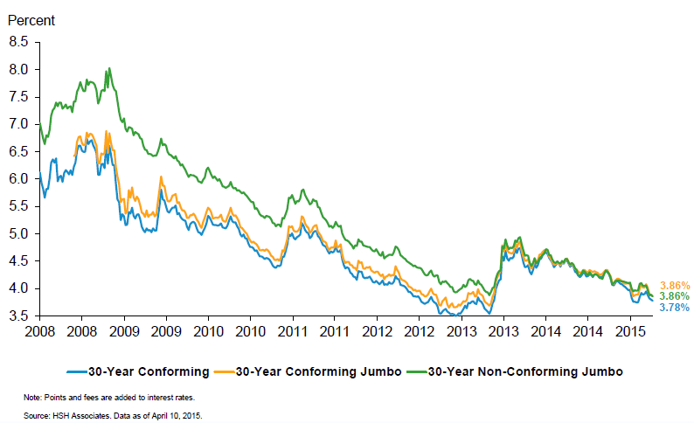
Rate Environment – 30Y Fixed Mortgage Rates

Slide 5
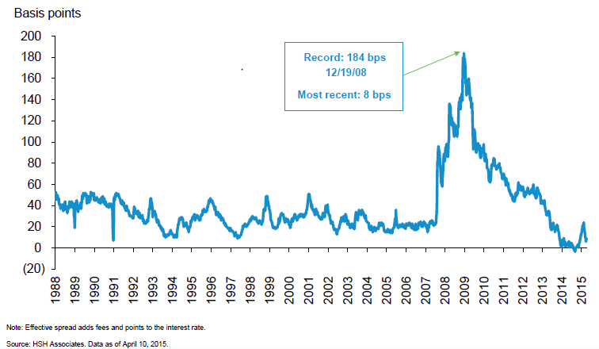
Rate Environment – 30Y Fixed Conforming / Jumbo Spread

Slide 6
Underwriting
Credit standards and documentation requirements remain rigorous
Increased scrutiny from agencies and secondary market investors around appraisal quality
Some easing in certain product categories
Lower down payments on Jumbo loans
Non-warrantable condominium financing
Certain cash out scenarios
h
More frequent requests for home equity lines of credit (HELOCs) and cash-out refinancing as value of home equity rises

Slide 7
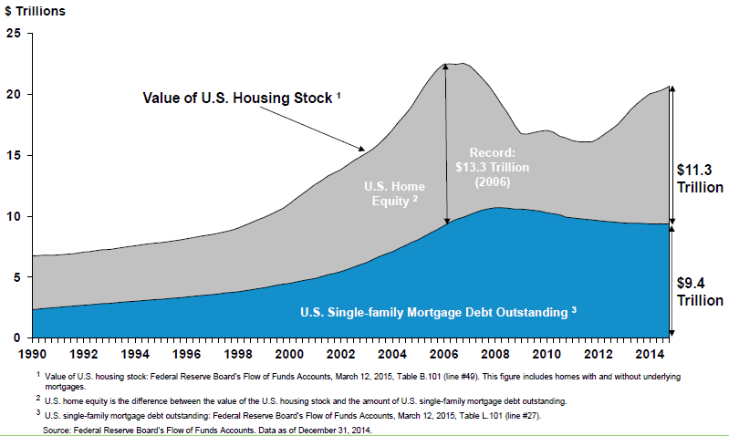
Cumulative Value of Home Equity– Single Family Residences

Slide 8
Mortgage Market Health – A Tale of Two Markets
Massachusetts
3.6% Y-o-Y Price Appreciation for Single Family Residences (Feb 28, 2015)
11.6% Homes with negative equity vs. 16.9% US Average (Dec 31, 2014)
8.3% Delinquent on mortgage vs. 6.3% US Average (Dec 31, 2014)
2.6 homes foreclosed per 10,000 vs. 3.0 US Average
Boston
7.6% Y-o-Y Price Appreciation for Single Family Residences (Feb 28, 2015)
10.4% Homes with negative equity vs. 16.9% US Average (Dec 31, 2014)
5.9% Delinquent on mortgage vs. 6.3% US Average (Dec 31, 2014)
1.8 homes foreclosed per 10,000 vs. 3.0 US Average
* Source: Zillow.com

Slide 9
Regulatory
Non-Qualified (QM) mortgages
Debt-to-income greater than 43%
Interest-only loans
Alternative Documentation
Non-QM mortgages are a growing share of mortgage market (~5% of originations), but still suffer from lack of liquidity and concerns about foreclosure liability.
Rating Agencies are preparing to assess performance risk of Non-QM backed securities, however the litigation wildcard presents a structuring challenge
Expect to see growth in non-QM lending as lenders strive for enhanced yield (150-250+ bps) in current rate environment, perhaps setting additional allowances aside.

Slide 10
Questions?
Mike Tassone, SVP
Leader Bank, N.A.
781-641-8683
mtassone@leaderbank.com

